Slide 1
Using The MySQL Library In C969/C195
V 1.0 – 01-27-2022
Part I – SQL Boot Camp
Mark Kinkead
Course Instructor C969/C195
Software II – C#/Java
Today’s Goals
Understand MYSQL Workbench
Understand The Difference Between A “Query”/”Non-Query”
Understanding Keys
A Quick Overview Of what is needed to manipulate the data for the project
Queries across more than one table
Insert/Update/Delete Across Tables
Using Count and Distinct when Needed
Functions and operators

Slide 2

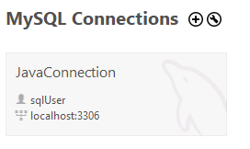
Working With MySql Workbench #1
MySql WorkBench is a separate application that allows you to view the contents and structure of the database.
It can be launched via this icon:
….and then you can login to the database with a new connection:

Slide 3
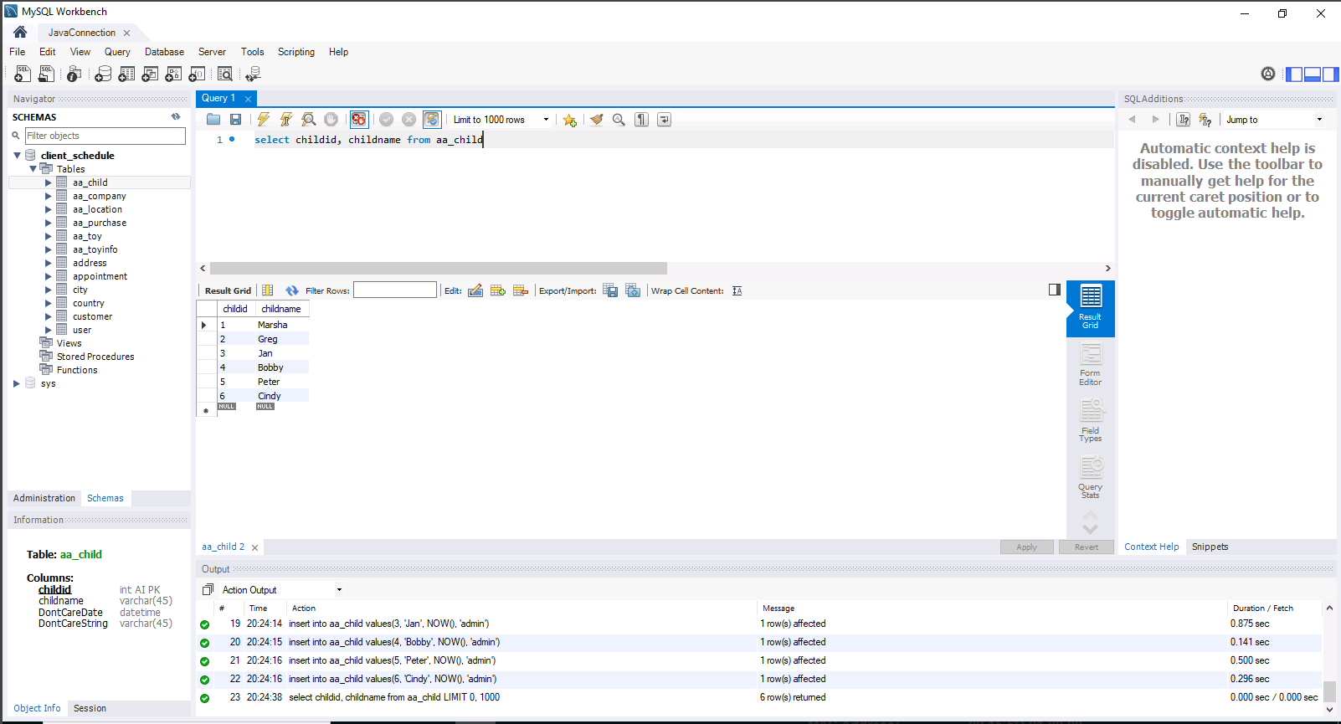
Working With MySql Workbench #2
“Execute Statement”
(Shazam Buttons)
Current Connection Tab
Initial Screen (House)
Add New SQL Notepad
Click This Button To Hide The “SQL Additions” Pane
Tables Displayed in ‘Schemas’
Make sure the Schemas Tab is set.
SQL Notepad
Notice it is tabbed
As You Can
Have Several Open
Selected Table Columns
(and order/types)
Query Result Set
Execution Output
Errors Appear Here

Slide 4
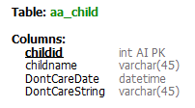
Understanding A Query # 1
A QUERY requests data from the database.
(SELECT….FROM….WHERE….)
SELECT * FROM aa_child ⬅ select every row from the aa_child table
SELECT childid, childname FROM aa_child ⬅ select child id and name from the aa_child table
SELECT childname FROM aa_child WHERE childid = 1 ⬅ select child name from the aa_child table
where the childid equals 1

Slide 5
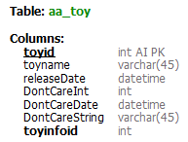
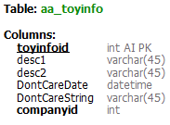
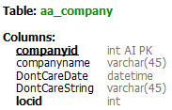
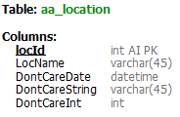
Understanding A Query # 2
A JOIN combines the tables in a QUERY to obtain related information.
I do what I call a “Lazy Join” which does not use the JOIN keyword but has the conditions in a WHERE clause.
This join follows the convention SELECT WHAT, FROM WHICH TABLES, WHERE WHAT RELATIONSHIPS EXIST
SELECT companyid, companyname, aa_company.locid, LocName ⬅ the what
FROM aa_company, aa_location ⬅ the tables
WHERE aa_company.locid = aa_location.locid ⬅ the relationships
I must make sure I identify the table where a duplicate column name is used: “aa_location.locid”
SELECT aa_toy.toyid, toyname, releaseDate, aa_toyinfo.toyinfoid, desc1, desc2, aa_company.companyid, companyname, aa_company.locid, LocName
FROM aa_toy, aa_toyinfo, aa_company, aa_location
WHERE aa_toy.toyinfoid = aa_toyinfo.toyinfoid AND aa_toyinfo.companyid = aa_company.companyid AND aa_company.locid = aa_location.locid

Slide 6
Understanding A Query # 3 Other Interesting Query Operators/Functions
SQL Functions have a pair of parens, and some take inputs. The function name and parents must not have a space between them.
Look for examples of these online.
NOW() ⬅ Returns the current moment in time in the DB. **You cannot use this for the 15 minute alert.
DATE_ADD() ⬅ Add time to a DateTime. Takes an ‘INTERVAL’
COUNT() ⬅ good for counting rows in a table
MONTH() and MONTHNAME() ⬅ Return the month number or month name of a DateTime
YEARWEEK() ⬅ Returns a number unique to year and week.
Comparators: =, <, >, <=, >=, <> ⬅ good for comparing numbers and dates
distinct ⬅ good for finding unique values in a large query of many rows.
EX: select distinct childname from aa_child will guarantee all returned data is unique in value, no duplicates.

Slide 7
Understanding Non-Query # 1
A NONQUERY manipulates data in the database.
(INSERT/UPDATE/DELETE)
INSERT -> add a new row of data
UPDATE -> change a row of data
DELETE -> remove a row of data
A Non-Query statement never uses a JOIN and can only be executed on one table at a time.

Slide 8
Understanding Non-Query # 2 INSERT
INSERT INTO aa_location VALUES(NULL, ‘Atlantis’, NOW(), ‘xx’, 0)
If done correctly, we can let the database automatically generate the ID for that row when we do an INSERT. Both C# and Java have code implementations that allow you to get back the key generated.
It is important to understand the table’s column order when doing a blanket insert.
For some columns, the value is not allowed to be ignored(NOT NULL) and something must be added. Sometimes we don’t care what we add as we do not use that data.

Slide 9
Understanding Non-Query # 3 UPDATE
UPDATE aa_company SET companyname=‘Home’, locid = 2 WHERE companyid = 3
You can set multiple columns to be updated separated by a comma.
With an update, you must identify the row being updated.
Only update the data you care about.

Slide 10
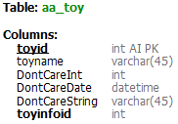
Understanding Non-Query # 4 DELETE
DELETE FROM aa_toyinfo where toyinfoid = 1
With a delete, you must identify the row being deleted.
You must be away of “foreign key references”. If another table has the row
being deleted as a foreign key link, the delete will fail.

Slide 11
Thanks For Watching
Mark.Kinkead@wgu.edu

Slide 12
Using The MySQL Library In C969
Part II – Connecting To The Database
In Visual Studio
Mark Kinkead
Course Instructor C969
Software II – C#
Today’s Goals
Build A Connection String and Connect To the Local Database
Look At Connection Errors
Reuse of the connection and connection string

Slide 13
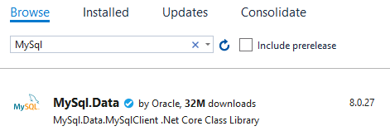

Build A Connection String
Add MySql.Data To the Project via NuGet Package Manager
Add A connection string to App.config

Slide 14
Write Code To Connect To the Database
Grab The Connection String
Declare A MySqlConnection and initialize it
Open The Connection
Close The Connection
What Happens When The Connection String is Incorrect?

Slide 15
Creating A Reusable Connection #1
A database connection should be considered a “resource”…So it is important within the context of you program to know and understand how you are using it.
Improper Use can result in performance issues, sharing issues, availability issues.
In a single user application, you can be pretty greedy. In a multi use application, you must be more careful. It is a good idea in any application to minimize how a resource is accessed in a code-base.

Slide 16
Creating A Reusable Connection #2
Code File A
Code File B
Code File C
Code File D
Create Conn
Use Conn
Close Conn
Create Conn
Use Conn
Close Conn
Create Conn
Use Conn
Close Conn
Create Conn
Use Conn
Close Conn
A database connection “open” is expensive time wise, in that a socket connection and credential verification is needed. Removing this aspect will save time.
Code File A
Code File B
Code File C
Code File D
GET Already Open Conn
Use Conn

Slide 17
Thanks For Watching
Mark.Kinkead@wgu.edu

Slide 18
Using The MySQL Library In C969
Part III – Query Operations
Mark Kinkead
Course Instructor C969
Software II – C#
Today’s Goals
Making A Query In C# MySql
Using an Adapter to collect data
Understanding DataTables for DataGrids and accessing data once retrieved
Understanding Binding List to hold objects or display in data grid
Using a Reader to collect data
Execute Scalar for single answer queries

Slide 19
Understanding A Query # 1
A QUERY requests data from the database.
(SELECT….FROM….WHERE….)
SELECT * FROM aa_child ⬅ select every row from the aaex_child table
SELECT childid, childname FROM aa_child ⬅ select child id and name from the aaex_child table
SELECT childname FROM aa_child WHERE childid = 1 ⬅ select child name from the aaex_child table
where the childid equals 1

Slide 20
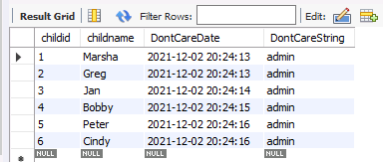
Using A DataTable
A Data Table is very much like the result set you see in the
MySQL Workbench when you make a query.
It has a Row list property to allow access to each row, and then you can use the column name string to access data on each row.

Slide 21
Getting Data From A DataTable
You Can Set it As A Data Grid Source For Visualization
You can look at a particular row in Rows and access it by the column name
The Column Name is the name as it appears in the query
Remember the index starts at 0

Slide 22


Getting a Query Into A DataTable (with Adapter)
Step # 1: Setup A Command
Step # 2: Setup The Adapter
Step # 3: “Fill” the DataTable with the Adapter
Always Catch The SQLException and handle it there!

Slide 23
Building Objects From a Query
Maybe we don’t want to display the data in a grid….maybe we need a List of objects we can work with and manipulate.
So our goal is to get objects into a List for data work, or a BindingList.
We will use a Reader/Class/BindingList for this.
We could use an Adapter/DataTable as well, it all depends on the circumstances.

Slide 24


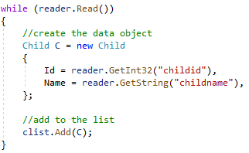

Getting a Query Into A BindingList (with Reader)
Step # 1: Setup A Command
Step # 2: Setup The Reader
Step # 3: Read each row, extract data, create an object, adding it to a list
Step # 4: Close The Reader

Slide 25


Using “ExecuteScalar” To Get a Single Value
Sometimes you know you are going to get one and only one piece of data from the database on a query. (sql COUNT for example)
In this case, you can use ExecuteScalar.
Be aware ExecuteScalar returns an object, and it can be problematic trying to cast it as a number. Always first use “toString” then Convert to get what you need:

Slide 26
Thanks For Watching
Mark.Kinkead@wgu.edu

Slide 27
Using The MySQL Library In C969
Part IV – Substitutions In MySql Commands
Mark Kinkead
Course Instructor C969
Software II – C#
Today’s Goals
Parameter Lists in Commands to add dynamic data

Slide 28
Using Substitution Benefits
Usable For SQL Statements for both Query or Non-Query
Keeps your sql string constant, avoids error prone concatenation
Make editing of queries and code simpler and more organized
Especially useful for DateTime objects, avoids formatting

Slide 29

Using Substitution In An SQL Line
Start with the sql, with one or more parameter place holders
Set Up The Command
Substitute each parameter you set with a value
Execute the Query or Non-Query (Use of ExecuteScalar here is just an example)

Slide 30


Two Different Techniques For Using Substitution
#1 “AddWithValue” (best – the value data type is defaulted)
#2 Two steps, Add the parameter and then set the value
Common Data Types To Be Used
Substitutions especially useful in Non-Queries for this project

Slide 31
Thanks For Watching
Mark.Kinkead@wgu.edu

Slide 32
Using The MySQL Library In C969
Part V – Non-Query Operations
Mark Kinkead
Course Instructor C969
Software II – C#
Today’s Goals
Insert
Hints For Multi-Table Insert Scenario (Like country-city-address-customer)
Updates
Deletions

Slide 33
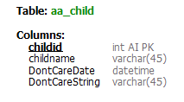
Understanding “blanket” INSERT #1
I must follow the table order in a blanket insert, which in this case is :
childId : the Value NULL is hard coded to allow the database to autogenerate the key
childname : This field I am using Parameters/Substitution. At runtime the value will be entered.
DontCareDate: since I do not care as to the data in this field, but it is required due to NOT NULL restrictions, I hard code the value NOW()
DontCareString: More data I do not care about but am forced to enter, I hard code the value ‘xx’

Slide 34


Understanding “blanket” INSERT #2
#0 Set SQL String
#1 Set up the command
#2 Set The Parameter(s)
#3 Execute Non-Query
#4 Get Auto Generated Id : MySqlCommand property LastInsertedId

Slide 35
Hints For The Multi-Table Insert Scenario #1 (Like country-city-address-customer)
In C969, you are required to allow the setting of the country name and city name and address details for a customer. Having this data in a customer editor is problematic as the data could be linked to other customers as well.
There are two ways to do this cleanly:
Have a Country Editor, City Editor, Address Editor separate from the Customer Editor to add/change information
Maintain a 1-1-1-1 relationship, so the customer has its own unique address/city/country.
I recommend #2 as it saves development time, though it pretty much breaks the spirit of a relational database. But it does meet the requirements for this assessment. If you have more time, #1 would be a good way to go.

Slide 36
Hints For The Multi-Table Insert Scenario #2 (Like country-city-address-customer)
The process would be the following steps in order:
Setup country insert command and execute
Get new countryId from the country command
Setup city insert command using countryId as a parameter
Execute city command
Get new city id form the city command
Setup address insert command using city id as a parameter
Execute address command
Get new address id from the address command
Setup customer insert command using the address id as a parameter
Execute customer command

Slide 37
Understanding UPDATE #1
On an update, I only worry about the columns I want to change. So I use parameters to set the values.
Multiple column updates are comma delimited:
I must specify the id of the row I am updating. If I do not do this, every row in that table will be updated!
You cannot update the row’s primary id key.

Slide 38


Understanding UPDATE #2
#0 Set SQL String
#1 Set up the command
#2 Set The Parameter(s)
#3 Execute Non-Query

Slide 39
Understanding DELETE #1
On a delete, I only need the query data criteria delete the entire row. In this particular case, I am using the childid.
I must specify the id of the row I am deleting. If I do not do this, every row in that table will be deleted!
Hint for C969: When deleting a customer, you must execute two separate deletions in order:
“DELETE from appointment where customerId = @CUSTOMERID” ⬅ remove appointments
“Delete from customer where customerid = @CUSTOMERID” ⬅ removes the customer

Slide 40

Understanding DELETE #2
#0 Set SQL String
#1 Set up the command
#2 Set The Parameter
#3 Execute Non-Query

Slide 41
Thanks For Watching
Mark.Kinkead@wgu.edu

